Slide 1
Introduction to Big Data Computing and Analysis Los Angeles City Procurement Data Analysis Guide: Dr. Jongwook Woo
Submitted by: Akash Gandhi
Akshay Ahirrao
Hitesh Jagtap
Priyal Mistry

Slide 2
Table of Contents
Overview of Project
Big Data Life Cycle
What is Apache Spark?
Flowchart
System Specifications
Databricks
Spark QL Queries and Visualization
Conclusion
References

Slide 3
Overview of Project
The act of obtaining or buying goods or services
Dataset contains the procurement information for the city of Los Angeles
The dataset size is 2GB. Used 580 MB for processing.
This analysis will help us in determining the expenses for the city in terms of year, department and item.

Slide 4
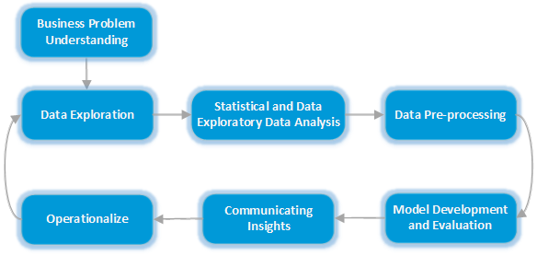
Big Data Life Cycle

Slide 5
What is Apache Spark?
Fast and general cluster computing system, interoperable with Hadoop.
Advantages
- Improve efficiency through in-memory computing primitives
- Improves usability through rich APIs in Scala, Java and Python

Slide 6
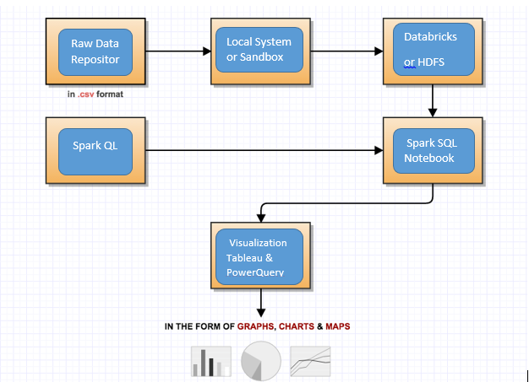
Flow Chart

Slide 7
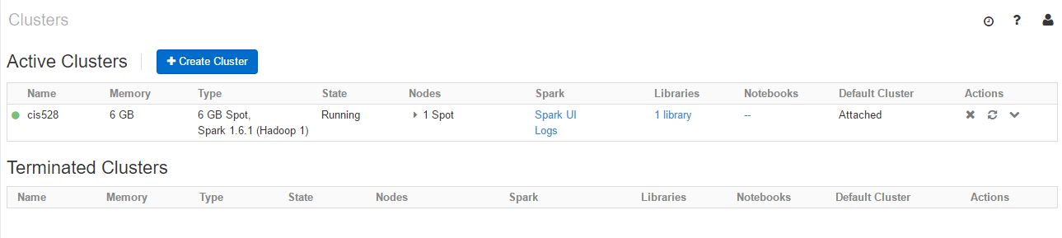
Databricks Cluster
Cluster size: 6 GB
No. of Cores: 0.88 cores
No. of nodes: 5
Spark 1.6.1

Slide 8
Advantages of Databricks
Cluster creation is quick.
Easy to terminate/ detach/ restart the cluster.
Can configure python code in SQL notebook.

Slide 9
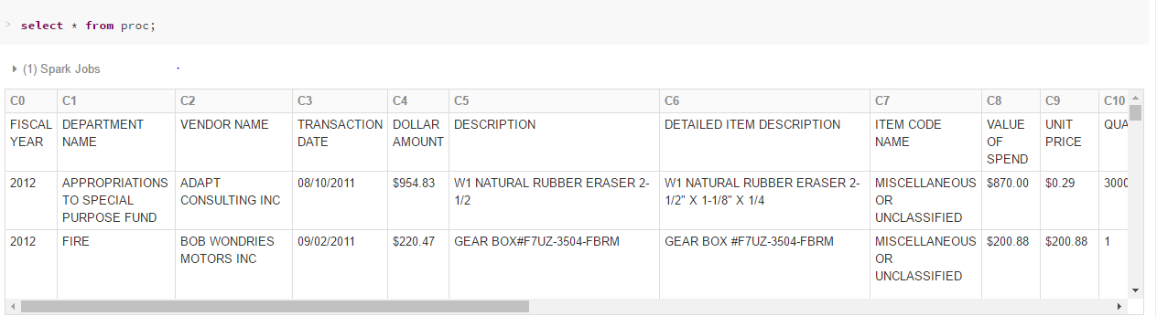
Loading Data to Table

Slide 10
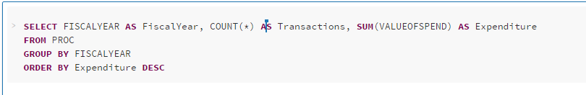
Query
To determine the Transaction count and Expenses Year-wise

Slide 11
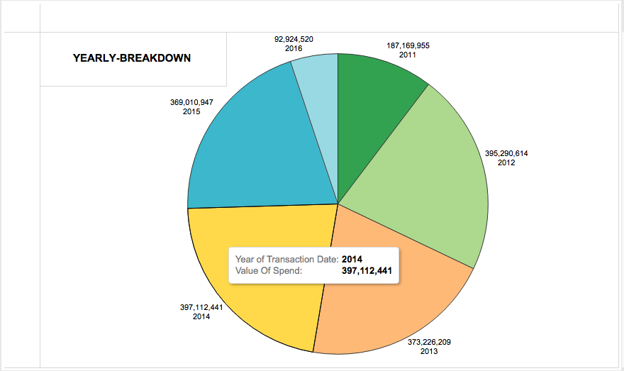
Visualization

Slide 12
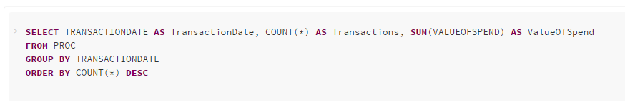
Query
To determine the no. of transactions and amount spent Date-wise

Slide 13
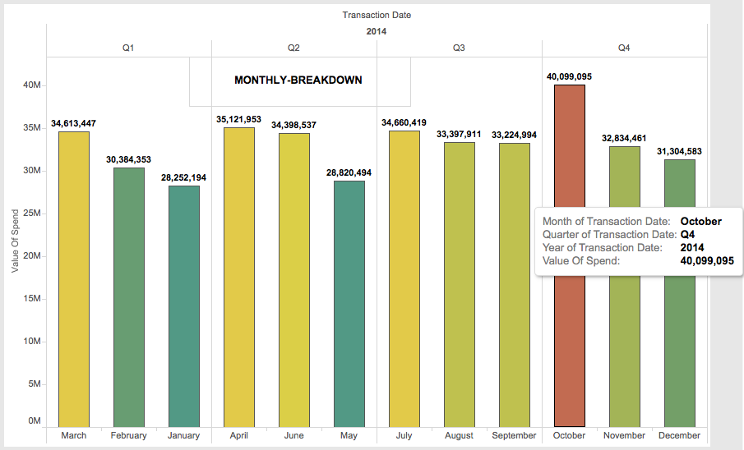
Visualization

Slide 14
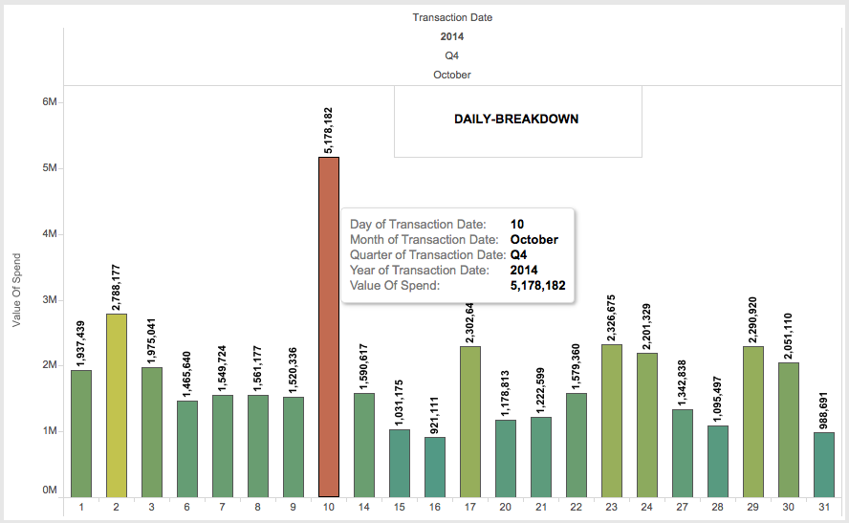
Visualization

Slide 15
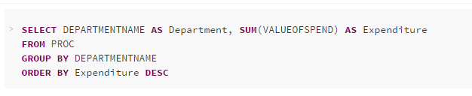
Query
To determine the Expenses Department wise.

Slide 16
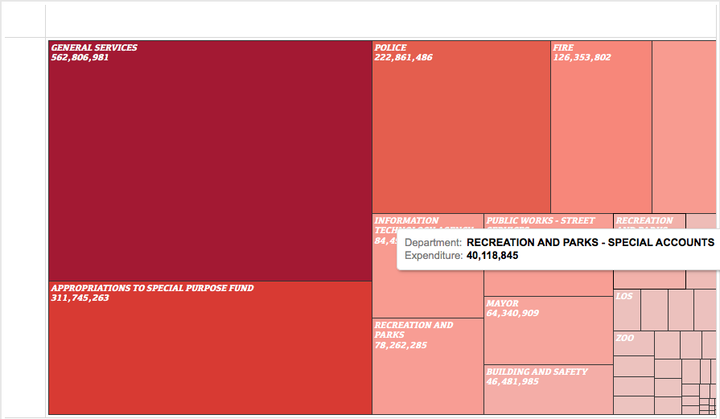
Visualization

Slide 17
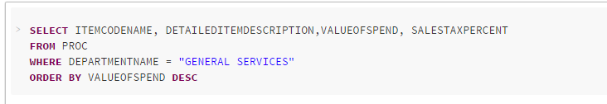
Query
To find the expenditure on ‘General Services’

Slide 18
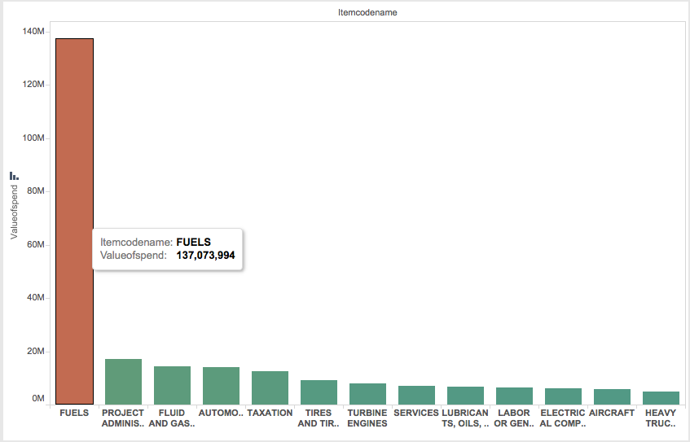
Visualization

Slide 19
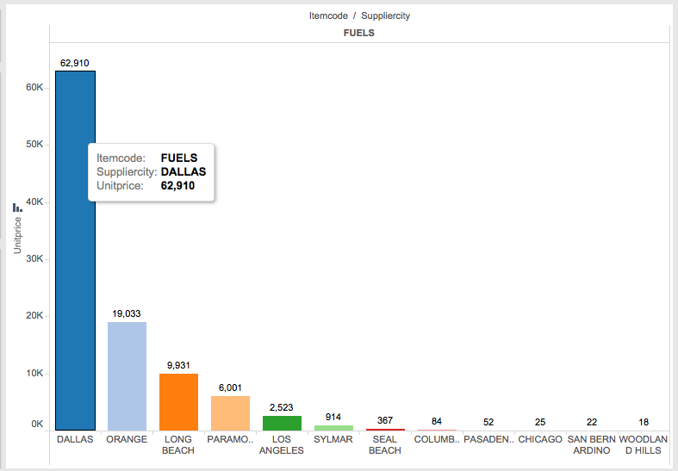
Visualization

Slide 20
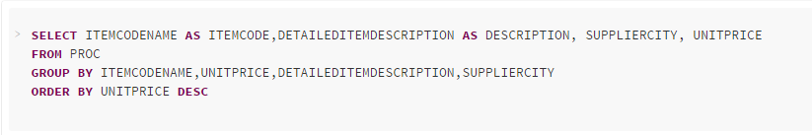
Query
Average amount spent on procurement items

Slide 21
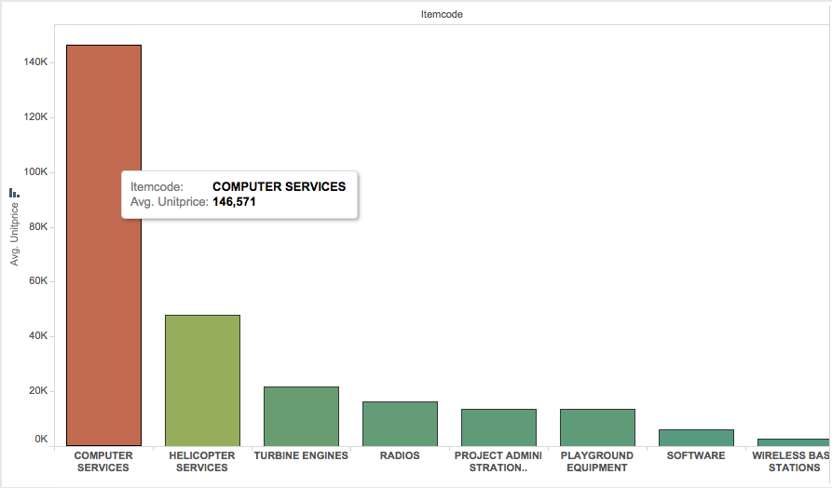
Visualization

Slide 22
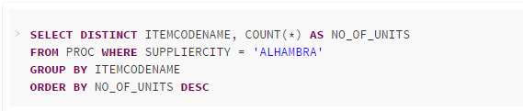
Query
To determine the Quantity of each Item supplied by Alhambra

Slide 23
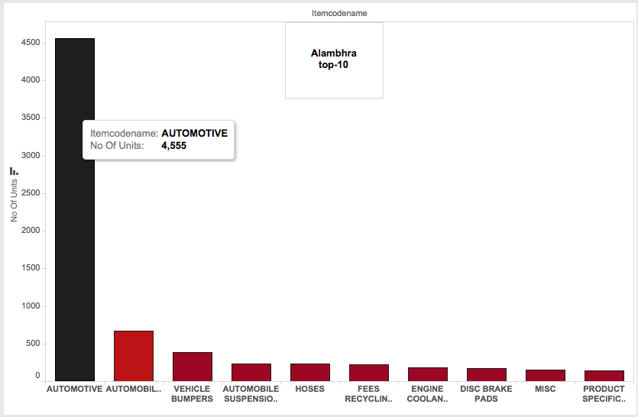
Visualization

Slide 24
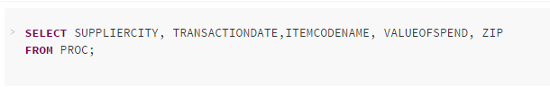
Query
To determine the Highest Selling City in terms of Item Count and Cost

Slide 25
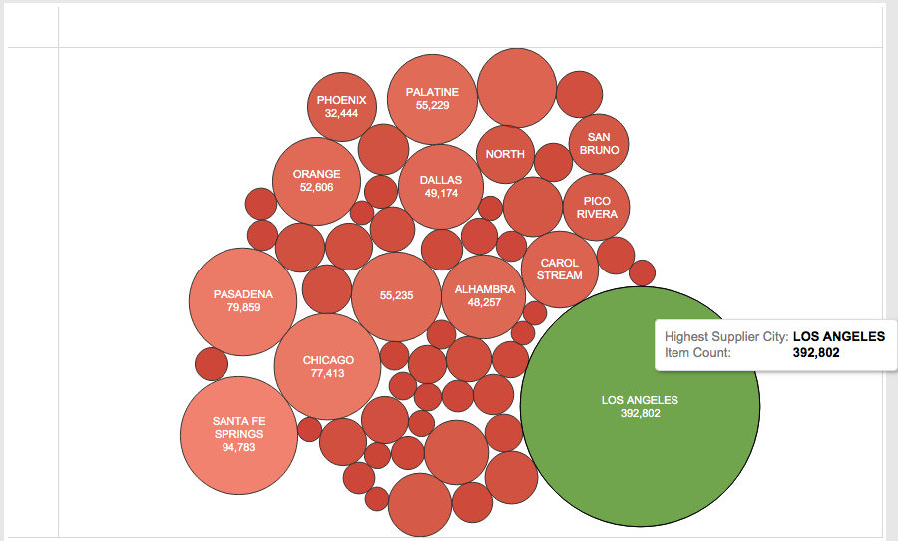
Visualization

Slide 26
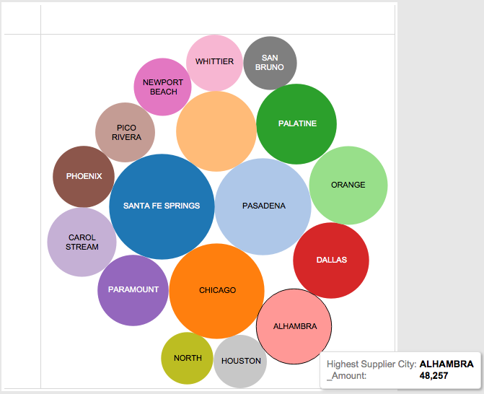
Visualization

Slide 27
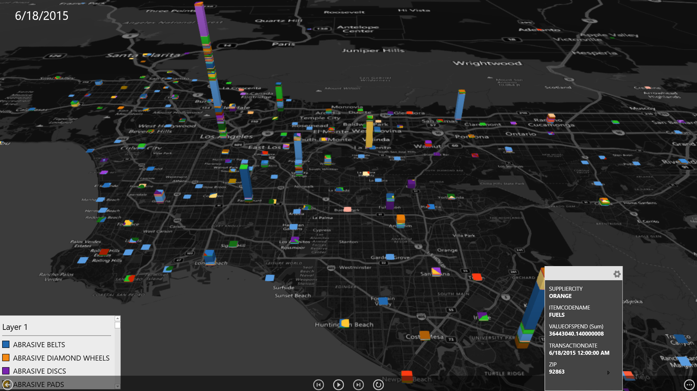
Visualization

Slide 28
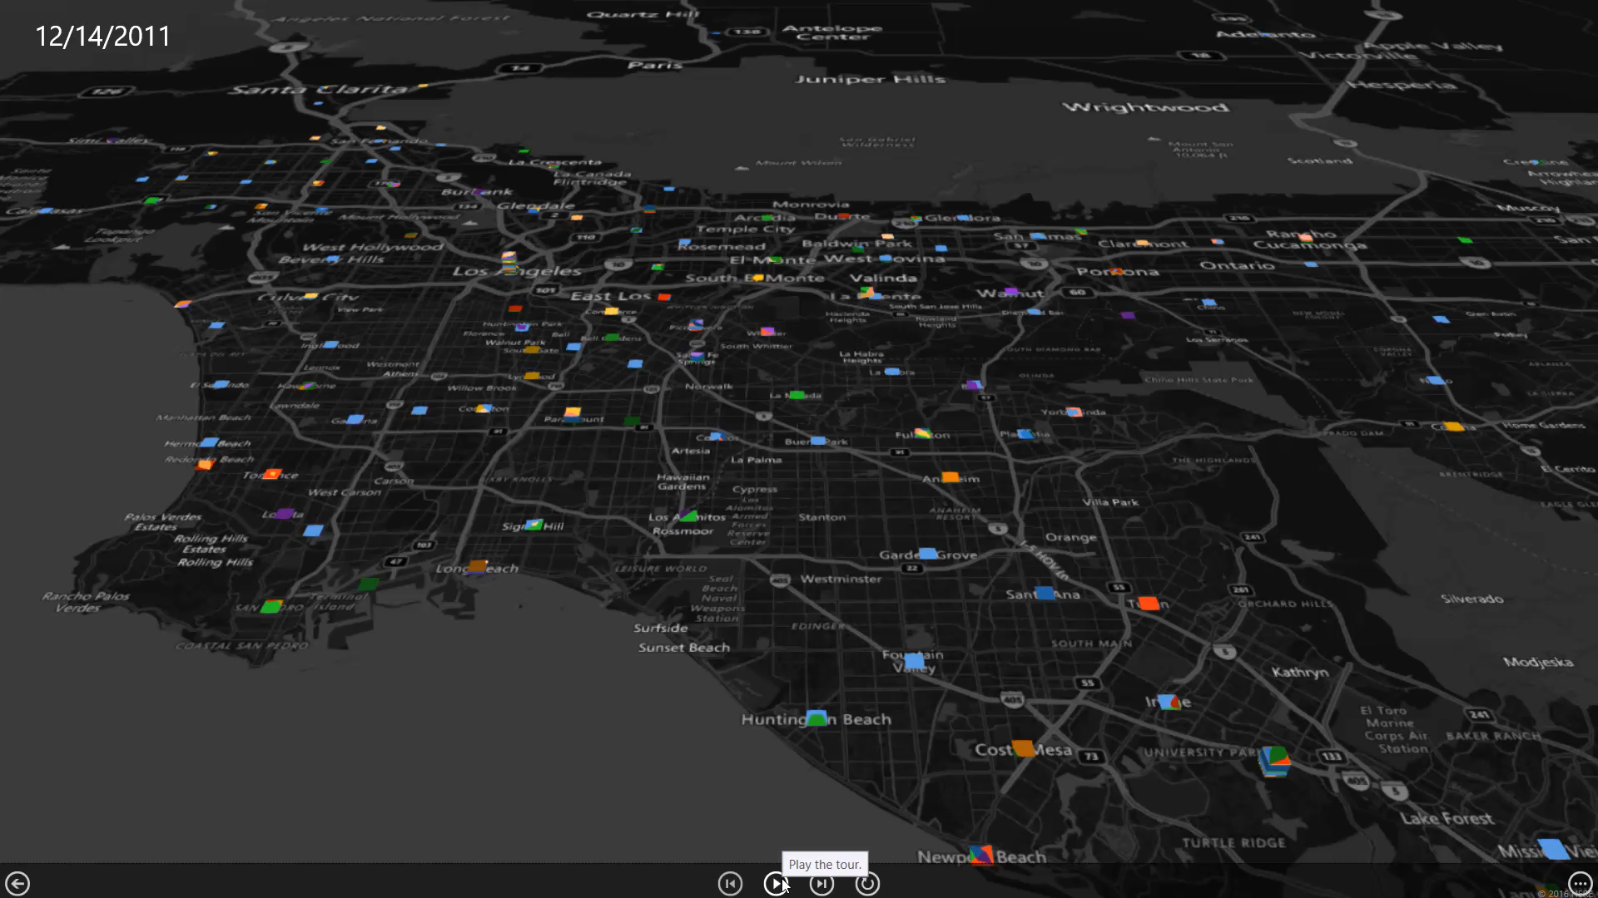
Conclusion

Slide 29
Conclusion
Transportation cost(Time and Money) for importing from distant cities
If the plants are built around LA, we will save on transportation cost and thus increase employment opportunities

Slide 30
References
https://controllerdata.lacity.org/Purchasing/LA-Procurement/xxkt-eu4z
https://community.cloud.databricks.com
https://spark.apache.org/docs/1.3.0/sql-programming-guide.html
GitHub : https://github.com/akashgandhi10/cis528.git
GitLab : https://gitlab.com/akashgandhi10/cis528.git
SlideShare: http://www.slideshare.net/akashgandhi10/cis-528-big-data-62605915

Slide 31
Thank You

